Slide 1

Communicate with People from Diverse Backgrounds and Situations
CHCDIV001 - Work with diverse people (Release 1)

Slide 2


Communication is:
The exchange of information between two or more people through a predefined set of words, symbols or actions
Performed day in and day out throughout all sectors of the world
Crucial in developing and maintaining relationships, relaying any concerns and giving and receiving information.
Individual persons bring their own beliefs, cultural values, customs and even languages to daily interactions.
Communicate with People from Diverse Backgrounds and Situations

Slide 3
Communicating with clients from diverse backgrounds challenges all workers.
It is important to:
Gain the appropriate cultural knowledge and skills to address the clients' specific needs
Ensure that the underlying meaning of each communication is clear and has been received in the manner it was intended
Ensure that the non-verbal messages you send show that you value the individual and diversity in general.
Communicate with People from Diverse Backgrounds and Situations

Slide 4
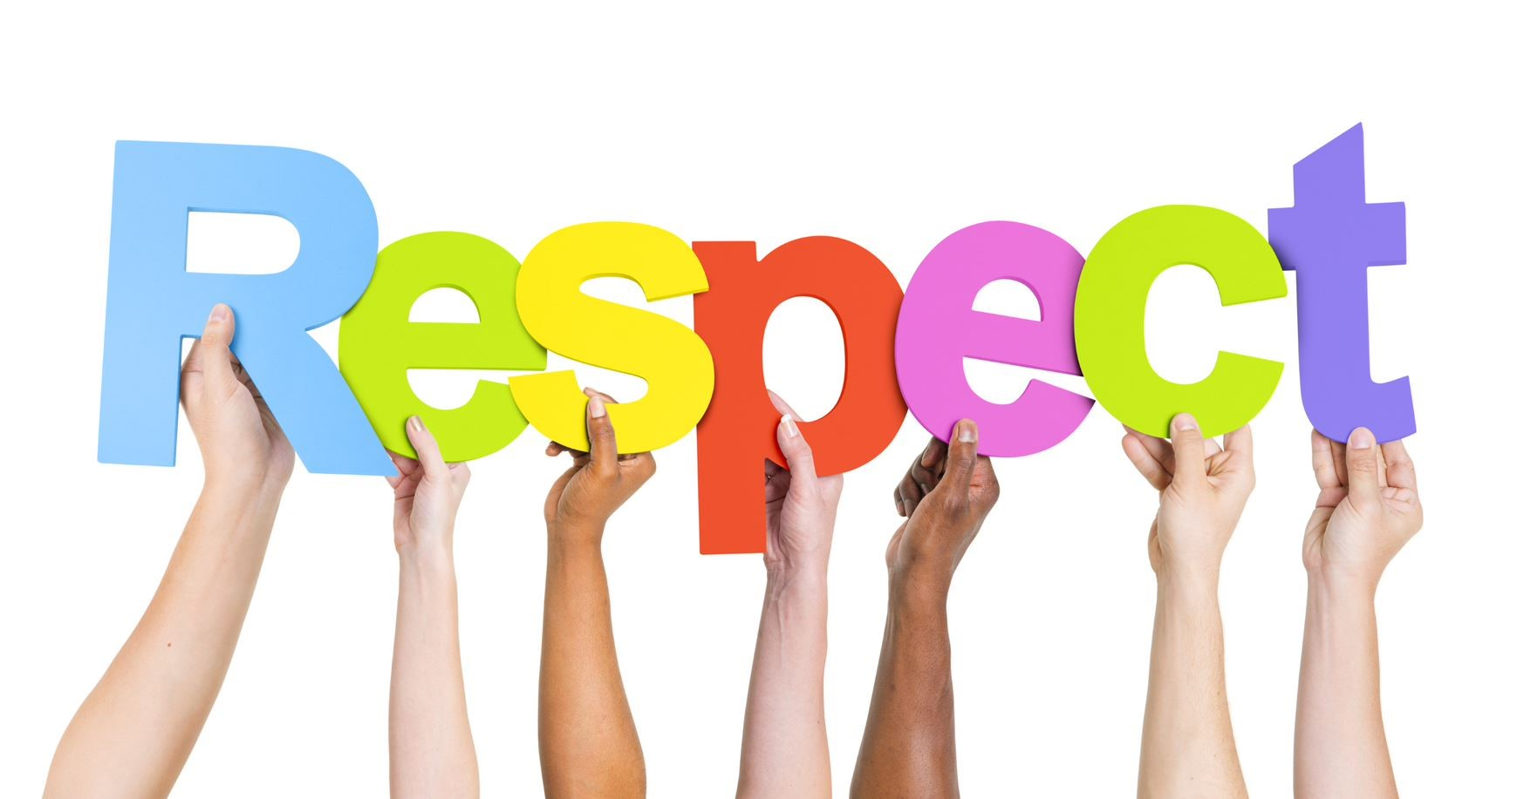
3.1 Show Respect for Diversity in Communication with All People

Slide 5
3.1 Show Respect for Diversity in Communication with All People
Showing respect means treating others with kindness and integrity. Respect develops the bond among workers.
People are inclined to work better with someone who treats them with respect.
One way to develop respect is to communicate in different ways.
Diversity in communication refers to the different ways of communicating with the persons in your workplace.
Communicate with People from Diverse Backgrounds and Situations

Slide 6
Diversity in communication is needed to communicate with people who:
Are from different nationality
Are from different cultures and background
Cannot speak verbally
Have disability
Are impaired in hearing or sight
Are diagnosed with a condition or illness affecting speech
Use English as their second language.
Communicate with People from Diverse Backgrounds and Situations

Slide 7
To show respect for diversity in communication with all people, you may use the following:
Listen closely
Be mindful of sensitive words
Use different ways of communication
Body language
Facial expressions and eye contact
Gestures and Movement
Voice tone and volume
Communicate with People from Diverse Backgrounds and Situations

Slide 8
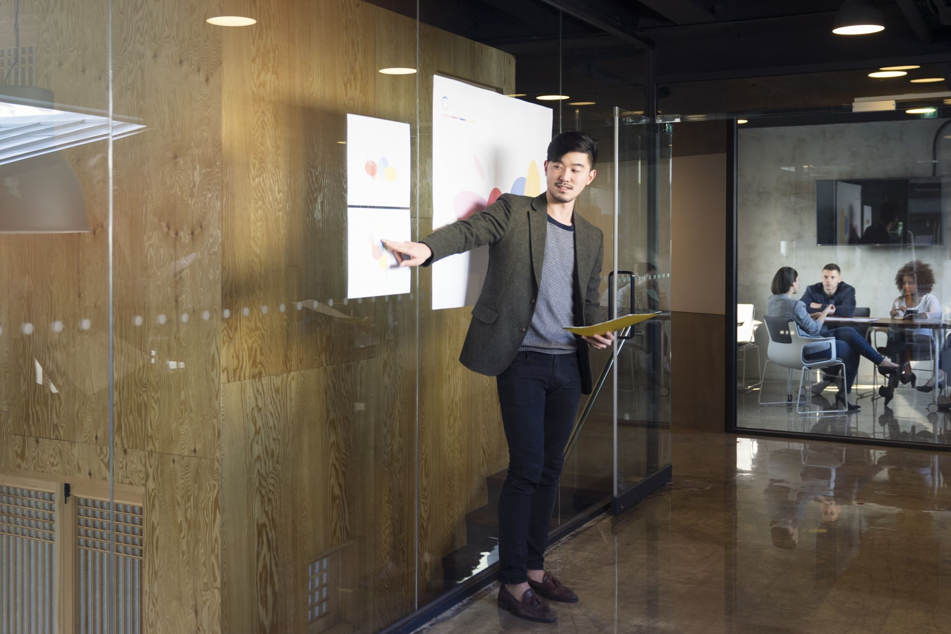
Aboriginal English
Language:
Is a key aspect of culture
Reflects what is vital to members of a certain cultural group.
Communicate with People from Diverse Backgrounds and Situations

Slide 9
Aboriginal English is:
The first language or home language of many Aboriginal people.
A distinctive language, which is a powerful way through which Aboriginal identity is transmitted.
Different from Standard Australian English, not only in words and meanings but also in grammar and ways of thinking and feeling.
Encompasses gestures, body language, eye contact, sounds, expressions and tone.
Communicate with People from Diverse Backgrounds and Situations

Slide 10
In most workplaces, the language spoken and used at work is 'Standard Australian English’.
Staff must recognise that Aboriginal clients and employees may speak a variant of Aboriginal English.
To show respect to Aboriginal and Torres Strait Islanders, you may use the following ways of communication:
Communicating face to face
Body language
Communicating in print
Communicating online
Communicate with People from Diverse Backgrounds and Situations

Slide 11
To show respect to Aboriginal and Torres Strait Islanders, you may use the following ways of communication:
Communicating face to face - When communicating face to face, it is important to remember that the level of English understood varies from community to community and from individual to individual.
Body language - Always observe others when communicating and rely on local knowledge. Be aware that there are distinct boundaries between males and females and practice appropriate behaviour at all times.
Communicate with People from Diverse Backgrounds and Situations

Slide 12
To show respect to Aboriginal and Torres Strait Islanders, you may use the following ways of communication:
Communicating in print - Print may be a useful way to provide information to key stakeholders and influencers and those with a medium to a high level of English proficiency.
Communicating online - Social media is an important mechanism for engaging and creating partnerships with other people whose messages and goals are closely aligned with your priorities.
Communicate with People from Diverse Backgrounds and Situations

Slide 13
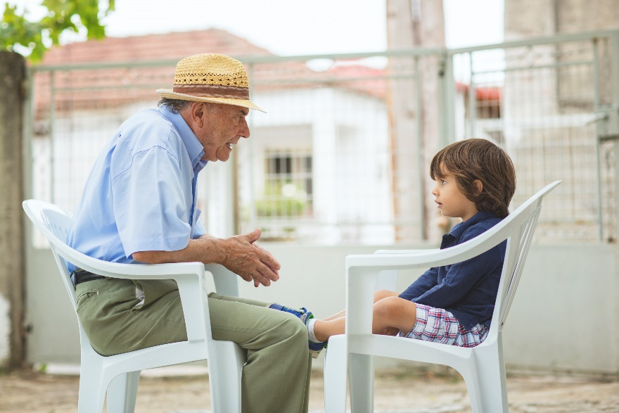
Non-English Speaking Persons
You may also come across clients who cannot or do not speak English.
Many factors can make it difficult, and in some cases, almost impossible for a person to learn and speak English.
The ability to learn English can be affected by the sex, age, and marital status of the migrant.
Communicate with People from Diverse Backgrounds and Situations

Slide 14
Here are some strategies to adopt when working with culturally or linguistically diverse people and diverse backgrounds.
Consider the language of choice.
Take the time to understand the 'rules' relating to non-verbal communication.
Ensure you have given adequate time with communication to obtain feedback and clarify understanding.
Avoid gratuitous or inappropriate references to culture by mentioning people’s race, culture, ethnic group or religion.
Communicate with People from Diverse Backgrounds and Situations

Slide 15
Impact of Culture on Communication
Depending on a person’s disability or country of origin, a person may find it difficult to communicate for a variety of reasons.
The language difference would pose a problem in ensuring successful communication.
Australians are individualistic, while people from East Asian nations are mostly collectivistic.
Communicate with People from Diverse Backgrounds and Situations

Slide 16

3.2 Using Verbal and Non-Verbal Communication Constructively in the Workplace

Slide 17

3.2 Using Verbal and Non-Verbal Communication Constructively in the Workplace
The most appropriate and effective way to consult with Aboriginal and Torres Strait Islander people and peoples from other cultures would be to go to their communities and meet in a place of their choosing
To do this, you must ensure an appropriate introduction to the community by seeking permission in advance.
Communicate with People from Diverse Backgrounds and Situations

Slide 18

Access can be gained through primary organisations representing the community (councils and cooperatives), community elders and local Aboriginal consultancy groups.
This could include assisting with preparation, providing advice, acting as interpreters, conducting interviews and facilitating discussion groups.
Communicate with People from Diverse Backgrounds and Situations

Slide 19
3.2.1 Verbal and Non-Verbal Communication
Verbal Communication
Verbal communication with diverse persons significantly differs with people from your cultural group.
Diverse persons may have their verbal styles or preferences regarding pace, tone, word choice and even politeness.
Communication consists of both verbal expressions and non-verbal cues or actions.
Communicate with People from Diverse Backgrounds and Situations

Slide 20
When verbally communicating with people from diverse backgrounds, you have to be aware of their needs.
Using appropriate language involves:
When in doubt, remember that it is always better to ask than to assume.
Choosing appropriate words
Avoid the use of discriminatory phrasing
Using a tone and pace that matches the perso’s preferences
Communicate with People from Diverse Backgrounds and Situations

Slide 21

You can always ask confirmation questions such as:
Is my voice too loud or too soft for you?
Did I use that word properly?
Am I talking too fast or too slowly?
Communicate with People from Diverse Backgrounds and Situations

Slide 22
The following are some general tips for successful communication:
Only refer to the person’s background or culture if necessary or relevant
Speak directly to the person, rather than their family, carer or other persons with them
Use a normal tone of voice
Be patient
Let the person know if you are having difficulty communicating with them
Communicate with People from Diverse Backgrounds and Situations

Slide 23
The following are some general tips for successful communication:
Be flexible – reword phrases or sentences rather than repeating something which was not understood
Ask the person what will aid with communication
Offer your assistance if it appears necessary, but respect the person's wishes if they do not accept your offer
Relax – apologise if you believe you have made a mistake
Communicate with People from Diverse Backgrounds and Situations

Slide 24

Non-Verbal Communication
Non-verbal communication will also be vital when working with diverse persons.
Using appropriate non-verbal communication strategies can make any client or co-worker feel at ease.
Communicate with People from Diverse Backgrounds and Situations

Slide 25
Non-verbal communication strategies
It refers to ways that you can communicate without speaking.
It must match your verbal strategies to prevent confusion or miscommunication.
It involves:
Maintaining or breaking eye contact
Using hand gestures
Communicate with People from Diverse Backgrounds and Situations

Slide 26

Non-verbal communication strategies
It involves:
Using appropriate facial expressions
Using visual cues such as pictures, graphs or signs
Conveying an appropriate overall body language.
Communicate with People from Diverse Backgrounds and Situations

Slide 27
The following are other examples of non-verbal communication:
Emblems or popular and easily identifiable signs
Illustrators or signs that mimic what people speak
Regulators or signs that convey meaning through the gesture alone
Affect displays or gestures that reveal emotions
Adaptors or gestures that show your reaction
Proxemics or ways of communicating by controlling space
Communicate with People from Diverse Backgrounds and Situations

Slide 28

Written Language
It is part of non-verbal communication.
It can refer to both the characters of the alphabet and the symbols and pictures people draw to convey meaning.
Communicate with People from Diverse Backgrounds and Situations

Slide 29
When communicating through written language, always remember the following considerations:
Make sure that the content of the written text you are creating follows the same rules as your verbal language.
When writing by hand, keep your text easy to read.
Avoid using sarcasm in your written text.
Your organisation should have policies and procedures for completing documentation and writing down any information.
Communicate with People from Diverse Backgrounds and Situations

Slide 30

Using Verbal and Non-verbal Communication
Here are some tips for using verbal and non-verbal communication in the workplace:
Some Aboriginal and Torres Strait Islander people and migrants may not speak, read or write English very well.
Communicate with People from Diverse Backgrounds and Situations

Slide 31
Here are some tips for using verbal and non-verbal communication in the workplace:
Consider using alternative methods of communication.
Written information should include pictures to assist in communication.
Consider acknowledging sensitive questions right from the start.
Be mindful of questions that can seem intrusive.
Communicate with People from Diverse Backgrounds and Situations

Slide 32
Here are some tips for using verbal and non-verbal communication in the workplace:
Avoiding eye contact is polite in some communities.
Be mindful of the message that your body language gives off.
Avoid finishing sentences for people.
Men's and women's business does exist in Aboriginal cultures.
Communicate with People from Diverse Backgrounds and Situations

Slide 33
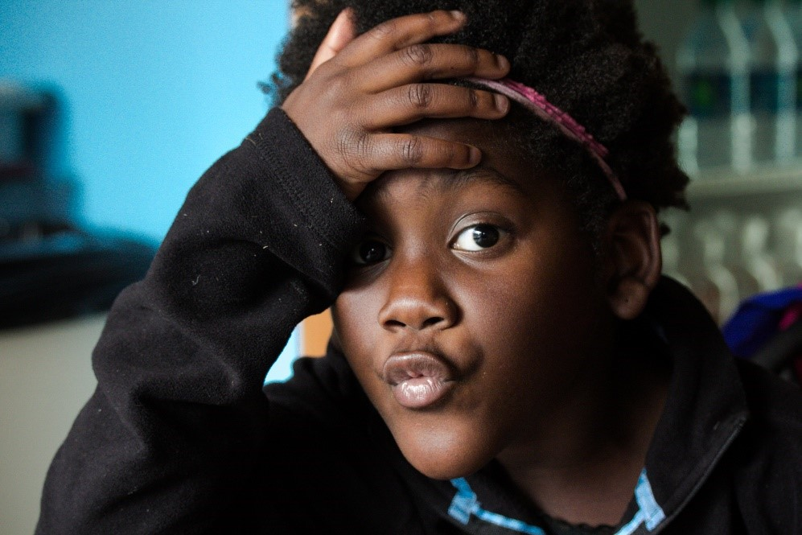
3.2.2 Constructive Communication
Intercultural or cross-cultural communication refers to understanding the use of Non-Verbal, Oral and Written messages to convey meaning.
When workers use all three forms of communication effectively, they can communicate much more than just the ideas and concepts they are expressing.
Communicate with People from Diverse Backgrounds and Situations

Slide 34
Sometimes, communication leads to conflicts with people from diverse backgrounds.
Mistakes can happen, and sometimes, the fault would not even be on you but on the person you are communicating with.
Constructive communication is:
A style of communication used when addressing issues or resolving conflicts
A direct style of communication that aims to find the root cause of the issue and work towards a scenario where all parties are satisfied.
Communicate with People from Diverse Backgrounds and Situations

Slide 35
To communicate constructively, you must do the following:
Identify the problem and isolate it from the person.
Focus on solving the problem instead of justifying past actions.
Be specific.
Own up to your responsibility.
Use active listening.
Communicate with People from Diverse Backgrounds and Situations

Slide 36
Here are some other considerations to keep in mind when communicating constructively to resolve conflicts and issues:.
Considerations | How they are used
Use nonverbal communication | It is helpful to use keywords and nonverbal strategies as they enhance communication with those who do not speak English well or not at all.
Speak slowly, not loudly | It is important to realise that speaking slowly conveys a more positive and appropriate meaning than speaking loudly.
Use gestures, facial expressions and pictures | You must watch the person’s face and body to look for inconsistencies between their body language and words. You must carefully double-check when a person’s verbal and non-verbal communication does not match.
Communicate with People from Diverse Backgrounds and Situations

Slide 37
Here are some other considerations to keep in mind when communicating constructively to resolve conflicts and issues:
Considerations | How they are used
Avoid uncommon and difficult words | Use clear, direct statements instead of idioms. Be aware of some phrases or sayings that may make sense to you and people within your culture but not people from other cultures.
Organise what you say | Use simple, short sentences, starting with the subject, followed as closely as possible with the simple object and/or verb.
Avoid yes or no questions | It is better to ask a question that requires information rather than a yes or no response.
Communicate with People from Diverse Backgrounds and Situations

Slide 38
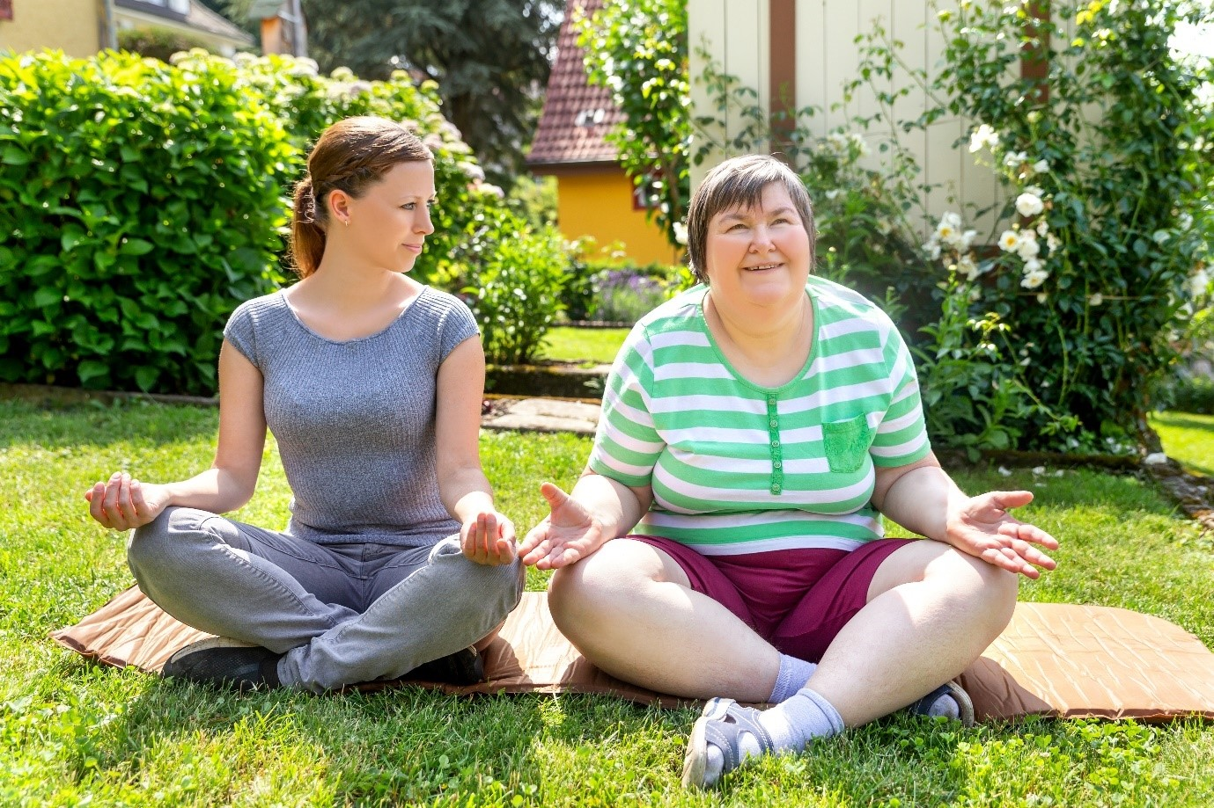
Outside of resolving conflicts and addressing issues, constructive communication can also provide the following benefits:
You and your client can develop mutual trust.
You and your client can establish a positive relationship.
You and your client can maintain confidence in one another.
Communicate with People from Diverse Backgrounds and Situations

Slide 39

3.3 Where a Language Barrier Exists, Use Effective Strategies to Communicate in the Most Efficient Way Possible

Slide 40
3.3 Where a Language Barrier Exists, Use Effective Strategies to Communicate in the Most Efficient Way Possible
Language barrier
It occurs when two people cannot communicate due to differences in their language.
It commonly occurs in workplaces with people from diverse backgrounds.
It does not necessarily mean that two people speak different languages while trying to make heads or tails of what the other person is saying.
Communicate with People from Diverse Backgrounds and Situations

Slide 41

The following are the most common types of language barriers you may encounter in the workplace:
Physical language barrier. Some people can have difficulty communicating because of physical impairments that cause them to speak or hear differently.
Communicate with People from Diverse Backgrounds and Situations

Slide 42
The following are the most common types of language barriers you may encounter in the workplace:
Cultural language barrier. This language barrier occurs when a concept is completely different between two cultures.
Proficiency language barrier. This occurs when two people of varying proficiency levels in one language are trying to communicate with one another.
Technical language barrier. This is exclusive for people who need to discuss technical terminology and jargon.
Communicate with People from Diverse Backgrounds and Situations

Slide 43
As a worker, you are also expected to provide service to clients despite language barriers.
To do this, you will have to use strategies to overcome the language barrier between you and your client.
Your choice of strategies will depend on what kind of client you are working with, what policies your organisation have and what your roles and responsibilities are towards your client and your organisation.
Communicate with People from Diverse Backgrounds and Situations

Slide 44
Depending on the strategy, you may need to use one or more of the following practices:
Being patient.
Build their vocabulary.
Ask questions.
Use visuals.
Use repetition and routines.
Seek assistance from interpreters, translators or other professionals.
Communicate with People from Diverse Backgrounds and Situations

Slide 45

3.4 Seek Assistance from Interpreters or Other Persons According to Communication Needs

Slide 46

3.4 Seek Assistance from Interpreters or Other Persons According to Communication Needs
In the workplace, your supervisor will provide you with assistance regarding any interpreters or professionals that will fully address your client’s communication needs.
Your organisation should also have policies and protocols for requesting assistance from these persons.
Communicate with People from Diverse Backgrounds and Situations

Slide 47
There are also state bodies or organisations that can help you get access to services from interpreters and other relevant professionals, such as:
The National Interpreter Symbol helps people identify where to ask for language assistance when using a service.
The Translating and Interpreting Service (TIS National) - an interpreting service provided by the Department of Immigration and Citizenship for people who do not speak English and agencies that need to communicate with them.
The majority of TIS National interpreting services are free for non-English speakers.
Communicate with People from Diverse Backgrounds and Situations

Slide 48

For Aboriginal and Torres Strait Islander translation services, it is best to contact the local state government department responsible for Aboriginal and Torres Strait Islander Affairs.
That is because they specialise in the local dialects.
Communicate with People from Diverse Backgrounds and Situations

Slide 49
Using Interpreters to Respond to Various Needs
Language interpreters, cultural interpreters, and even the use of visual resources aid in making the diverse population feel more welcome.
Language interpretation is the process through which one expression or source of information provided through a certain language is expressed in a different language.
Communicate with People from Diverse Backgrounds and Situations

Slide 50
Language interpreters provide the following benefits in the workplace:
They enable employees to understand and communicate better with coworkers who speak a different language, reducing miscommunication and fostering mutual respect.
They are useful when a conflict needs to be settled that might arise due to differences in language, whether oral or sign language.
They provide translations on a real-time basis.
Communicate with People from Diverse Backgrounds and Situations

Slide 51
Cultural interpretation is a process where an interpreter facilitates the exchange of ideas and information between people from diverse backgrounds and others.
Cultural interpreters are:
More ‘cultural experts’ than just interpreters.
Are useful when employees or management must become culturally sensitive to their clients or co-workers.
Communicate with People from Diverse Backgrounds and Situations

Slide 52
Cultural interpreters provide the following benefits:
They assist workers and employers in becoming more aware of their own culture as well as the culture of others.
As mediators, they can help everyone respect and accept other people outside their immediate culture.
They can account for and prevent unexpected differences in meaning and connotation that may arise during the conversation.
They can explain why things are as they are.
Communicate with People from Diverse Backgrounds and Situations

Slide 53

Visual resources
They are used by interpreters and ordinary workers in the workplace.
They help make everyone from other cultures feel represented and recognised, which gives them the feeling of ownership and an acknowledgment that their culture matters.
Communicate with People from Diverse Backgrounds and Situations

Slide 54
Assess Language Needs
Before requesting the help of an interpreter, it is important to first assess the actual language needs of your client.
To do this, you must:
Identify what information or text needs to be translated before speaking with the client.
Clarify what needs to be discussed, and ask for ideas on who can help interpret.
Identify jargon and other difficult concepts.
List down some issues you may have identified or experienced in past interactions.
Communicate with People from Diverse Backgrounds and Situations

Slide 55
A wide assortment of multicultural service providers throughout Australia:
Assist migrants and refugee communities in connecting with others.
Include community non-profit organisations in the local community to state multicultural government services
Can provide a range of support, depending on your organisation’s needs.
Communicate with People from Diverse Backgrounds and Situations

Slide 56
Each state has a website to access information about services and organisations:
State/Territory | Multicultural Support Agencies
Northern Territory (NT) | Multicultural Directory - Northern Territory Government
New South Wales (NSW) | Multicultural NSW
Queensland (QLD) | Multicultural Affairs
Victoria (VIC) | Victoria multicultural commission
West Australia (WA) | Office of Multicultural Interests
South Australia (SA) | Multicultural Affairs SA Directory of Community Services
Tasmania (TAS) | Migrant Resource Centre Tasmania
Communicate with People from Diverse Backgrounds and Situations

Slide 57

What have we learnt?
In this part of the session, we have covered:
Reflect on your perspectives
Appreciate diversity and inclusiveness, and their benefits
Communicate with people from diverse backgrounds and situations
Promote understanding across diverse groups

Slide 58
End of Chapter 3

